Slide 1
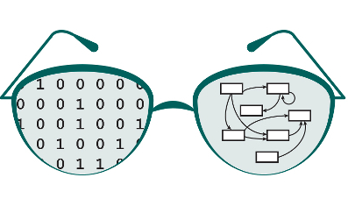


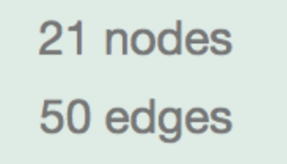
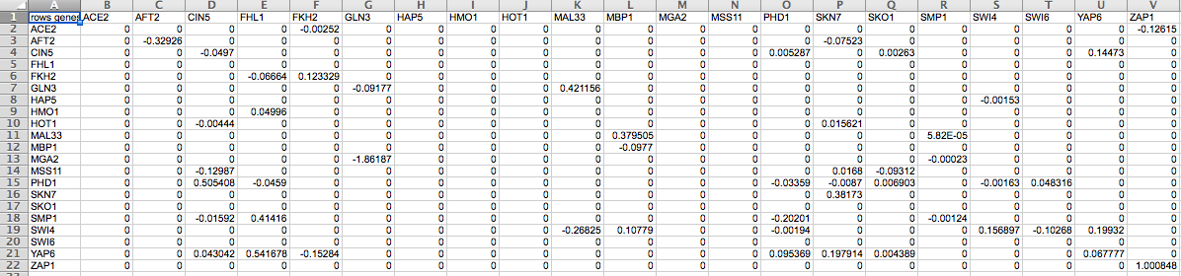

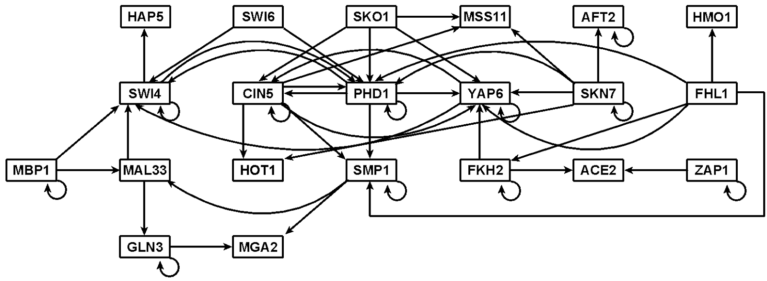
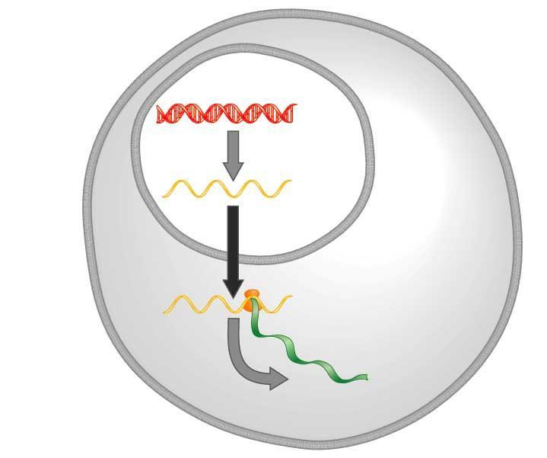
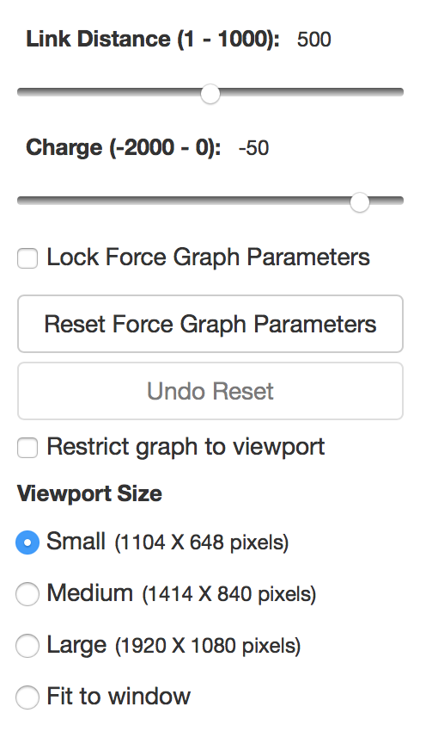
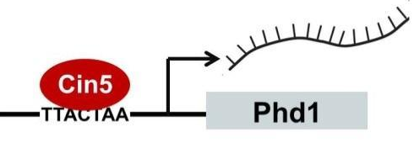
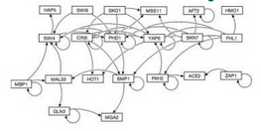
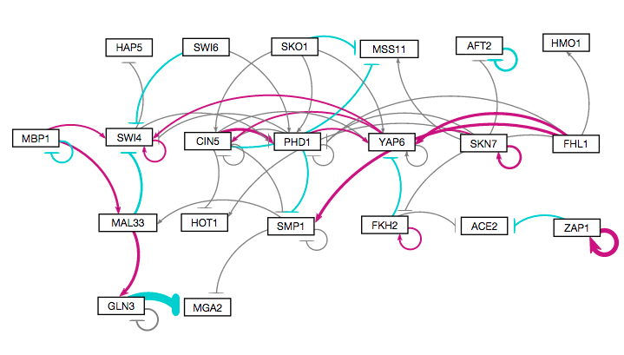
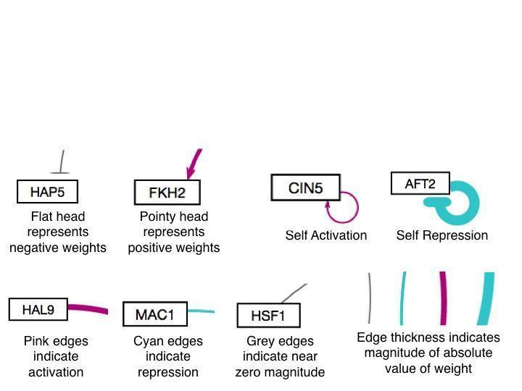
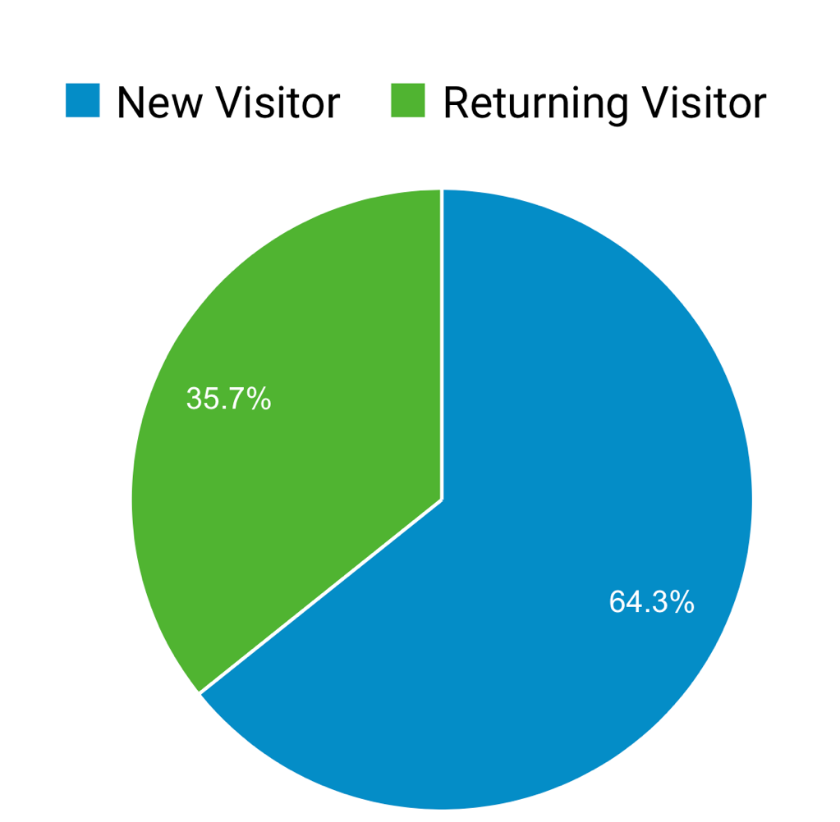
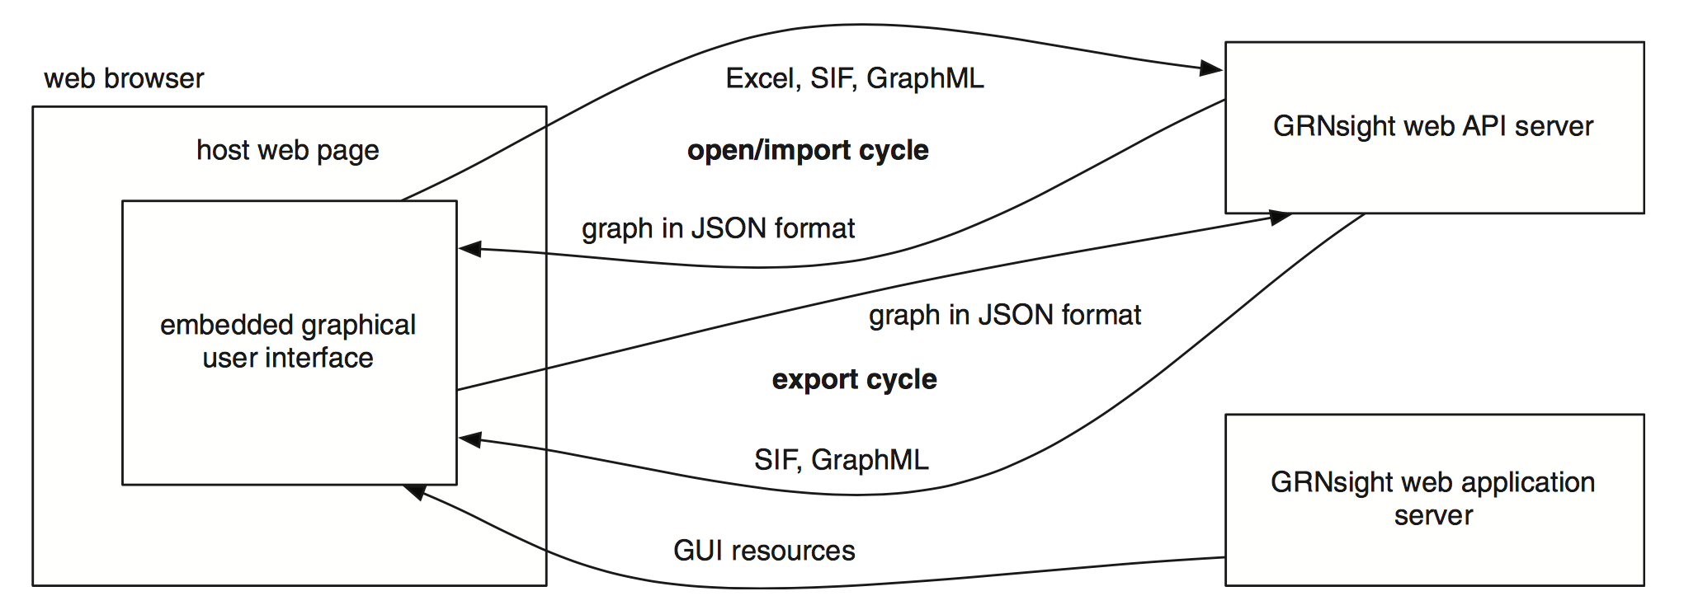
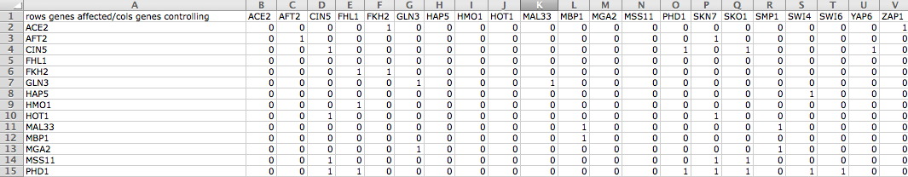
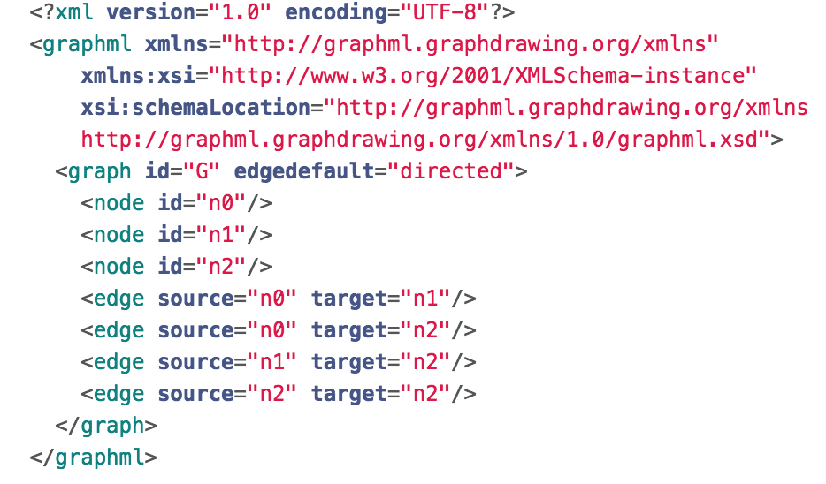
Data Comparison Features and Development Tool Improvements for
GRNsight: a web app for visualizing gene regulatory networks
Mihir Samdarshi*, Eileen Choe**, Edward Bachoura**, Yeon-Soo Shin**, John David N. Dionisio**, Kam D. Dahlquist*
*Department of Biology, **Department of Electrical Engineering and Computer Science, Loyola Marymount University, 1 LMU Drive, Los Angeles, CA 90045
http://dondi.github.io/GRNsight/
Gene Regulatory Networks (GRNs) Can Be Illustrated by Directed Graphs
GRNsight Automatically Lays Out Unweighted and Weighted Network Graphs
Improved Developer Tools
The central dogma of molecular biology describes how the flow of information in a cell during gene expression goes from DNA to RNA to protein.
Transcription factors control gene expression by binding to regulatory DNA sequences.
Activators increase gene expression.
Repressors decrease gene expression.
Transcription factors are themselves proteins encoded by genes.
Freeman (2002)
A gene regulatory network (GRN) consists of genes, transcription factors, and the regulatory connections between them, which govern the level of expression of mRNA and proteins from those genes.
Each node in a GRN graph represents the gene, mRNA, and protein expressed from the gene; each edge represents a regulatory relationship.
All the nodes are transcription factors themselves.
Excel Spreadsheet
1
4
Unweighted graph drawn manually with Adobe Illustrator
D3 visualization library was updated to version 4
D3 is the central visualization code library that GRNsight uses to lay out nodes and edges in the appropriate manner
GRNsight previously used d3 version 3.
Transitioning to version 4 allowed for a more concise and logical code base, allowing developers to read code easier and code to compile faster.
The “Gravity” and and “Charge Distance” features previously present in GRNsight were consolidated into “Link Distance” and ”Charge”
3. Weighted graph laid out automatically
1. Menu Bar
Four demo files can be found in the “Demo” menu for users who do not have their own data.
Print functionality is accessed from the “File” menu option.
“File > Reload” reloads the current graph with the active settings.
In the “Edit > Preferences” menu, the user can select for weighted graphs to be displayed as unweighted graphs.
2
Produced in several hours
DNA
Unweighted graph laid out automatically by GRNsight and adjusted by hand
RNA
ESLint added to code base
ESLint is a “linter,” a tool to identify and correct Javascript mistakes and coding style errors that developers may make while contributing to GRNsight.
The addition of ESLint ensures that all GRNsight code is consistent with style guidelines and can correct “fatal” coding mistakes prematurely.
Protein
2. Force Graph Parameter Sliders
Link distance determines the minimum distance between nodes.
Nodes have a charge, which repels or attracts other nodes.
The charge distance determines at what range a node’s charge will affect other nodes.
Gravity determines the strength of the force holding the nodes to the center of the graph.
Reset functionality sets all parameters to default settings.
Locking the parameters prevents any further changes.
Produced in ~5 minutes
Additional Developer Tools
An automatic client-side test generator was created that generates a document that can be followed by a user to manually systematically test specific combinations of user interface functions
Produced in ~10 milliseconds
Weighted graph laid out automatically by GRNsight and adjusted by hand
3. Nodes, Edges, and Arrows
The absolute values of each weight parameter are normalized to a value between 0 and 1. The thicknesses of the lines are adjusted to vary continuously from the minimum thickness (for normalized weights near zero) to the maximum thickness (normalized weights of 1).
Edges with negative weights (repression) are colored cyan with blunt end markers; edges with positive weights (activation) are colored magenta with pointed arrowheads; edges with normalized weight values between -0.05 and 0.05 are colored grey to signify a weak influence on the target gene.
GRNsight Fulfills a Specific Software Niche for Visualizing Small- to Medium-scale GRNs
Although other open source software, such as Cytoscape or Gephi, exists to lay out large networks, they were too cumbersome for our needs.
GRNsight is targeted at both experienced biology investigators and novice undergraduate users and has the following requirements:
Exist as a web application.
Be simple and intuitive to use.
3. Accept Excel (.xlsx) files directly from our sister project, GRNmap, as well as, SIF (.sif), or GraphML (.graphml) input files.
Read a weighted or unweighted adjacency matrix.
Automatically lay out and display unweighted and weighted, directed network graphs.
Produced in ~5 minutes
4. Status Bar
The name of the uploaded file is displayed.
The number of nodes and edges of the graph are displayed in the far right hand side.
Future Directions
GRNsight Has Sophisticated Architecture and Follows
Open Source Development Practices
New Data Comparison Features and Testing Improvements
Further expand and refine the unit testing framework.
Allow users to set edge thickness normalization values so that different graphs can be compared on the same scale.
Calculate and present graph statistics, such as betweenness centrality.
Add new graph layout options.
GRNsight Accepts Microsoft Excel, SIF, and GraphML Files in the Proper Format
GRNsight has a service-oriented architecture
GRNsight has two pieces: a server and a web client.
The server uses the node.js framework to receive and parse the Excel spreadsheet, SIF, or GraphML file uploaded by the user.
The web client receives the data from the server and generates the graph visualization.
Improvements to Zoom Functionality
Zoom was first added in GRNsight version 2.0, and has been improved since
Zoom now originates from the center of the graph
Zoom factor is now annotated on zoom slider
A vertical bar on the zoom slider indicates where the 100% zoom level is
Availability
Excel
Excel workbooks need a “network” sheet (for unweighted graphs) or a “network_optimized_weights” sheet (for weighted graphs). The adjacency matrix can be symmetrical or asymmetrical.
GRNmap input and output workbooks are accepted without adjustment.
Adjacency matrices generated from other databases, such as YEASTRACT (Teixeira et al., 2014), can be used with some modification.
GRNsight is free and open to all users and there is no login requirement.
Web site content is available under the Creative Commons Attribution Non-Commercial Share Alike license.
GRNsight code is available under the open source BSD license.
Usage is being tracked through Google Analytics.
GRNsight has been tested with and confirmed to be working in Chrome version 53 or higher and Firefox version 48 or higher on Windows 7 and Mac OS X.
Customization of Normalization Factor
Normalization controls how the thicknesses of the edges are determined based on the weight values
Users can now input their own normalization values to help separate edges based on their weight
The user can also set the threshold upon which a weighted edge is colored gray using a slider
GRNsight now accepts SIF and GraphML files without any modification
5564 total visitors and
2019 files uploaded as of
26 January 2017
SIF
A SIF file is a tab-delimited text file with the file extension .sif originally created for use with Cytoscape.
Lines in the SIF file specify a source node, a relationship type (or edge type), and one or more target nodes separated by tab characters.
Mocha and Chai JavaScript testing framework
The unit testing framework consists of 216 passing tests covering over
500 test files.
The addition of SIF and GraphML file format options besides the existing Excel imports, required re-organization of the testing framework.
Testing is now split into two different test groups, with semantic tests being file-format independent, and individualized syntactic tests being based on the different file formats.
Errors found in the semantic checker test are generally considered fatal, whereas most of the syntactic checker tests return warnings and still display the graph.
Syntactic tests for malformed GraphML XML (.graphml) and Simple Interaction Format (.sif) files were completed and incorporated into one file. These tests return errors to the user if an incorrectly formatted file is imported into GRNsight
Tests for incorrectly named Excel worksheets were added
GRNsight now returns an error if a blank Excel, SIF , or GraphML file is uploaded
Acknowledgments
GRNsight implementation takes advantage of other open source tools
GRNsight uses the Data-Driven Documents (D3) JavaScript library to generate a graph derived from input network data.
D3 dynamically manipulates HTML and Scalable Vector Graphics (SVG) to form the elements of the graph.
GRNsight implements D3’s force layout algorithm which applies a physics-based simulation to the graph.
D3 also allows for the fine tuning of Cascading Style Sheets (CSS), the code that styles web pages.
GRNsight follows an open development model using an open source github.com code repository and issue tracking.
This work is partially supported by NSF award 0921038 (K.D.D., B.G.F.), a Kadner-Pitts Research Grant (K.D.D.), the Loyola Marymount University Rains Research Assistant Program (N.A.A.), and the Loyola Marymount University Summer Undergraduate Research Program (A.V.).
GraphML
A GraphML file is an Extensible Markup Language (XML) file with the extension .graphml.
GRNsight parses GraphML to extract nodes and edges.
GraphML has the ability to specify additional graph features that GRNsight cannot display, but may be useful additional data.
References
Cytoscape: http://cytoscape.org
Dahlquist, K.D., Dionisio, J.D.N., Fitzpatrick, B.G., Anguiano, N.A., Varshneya, A., Southwick, B.J., Samdarshi, M. (2016) GRNsight: a web application and service for visualizing models of small- to medium-scale gene regulatory networks. PeerJ Computer Science 2:e85. DOI: 10.7717/peerj-cs.85).
Dahlquist, K.D., Fitzpatrick, B.G., Camacho, E.T., Entzminger, S.D., and Wanner, N.C. (2015) Parameter Estimation for Gene Regulatory Networks from Microarray Data: Cold Shock Response in Saccharomyces cerevisiae. Bulletin of Mathematical Biology, 77(8), 1457-1492, DOI: 10.1007/s11538-015-0092-6
D3.js: http://d3js.org/
Freeman, S., (2002). Biological science, 1st edition. Upper Saddle River, NJ:: Prentice Hall.
Gephi: https://gephi.org
GRNmap: http://kdahlquist.github.io/GRNmap/
Teixeira, M. C., Monteiro, P. T., Guerreiro, J. F., Gonçalves, J. P., Mira, N. P., dos Santos, S. C., ... & Madeira, S. C. (2014). The YEASTRACT database: an upgraded information system for the analysis of gene and genomic transcription regulation in Saccharomyces cerevisiae. Nucleic Acids Research, 42(D1), D161-D166, DOI: 10.1093/nar/gkt1015
Notes:
Kill abstract
Change to sans serif font
Make title bigger
Make title background white
Use full names
Super script to associate names with correct department
Background color: make it dark green, make writing on white background and writing in black/dark green
4 columns!!!
Smaller pictures
Bold titles
References can be 12pt
Acknowledgements can be 16pt
Everything else is 18-24pt
Titles don’t need to be bigger than 36pt
Remove circles from the arrowhead diagram, group the related labels together
Include menu bar
Testing/error handling – sample error (we don’t crash with errors!)
Mouseovers for edges screenshot

